Slide 1
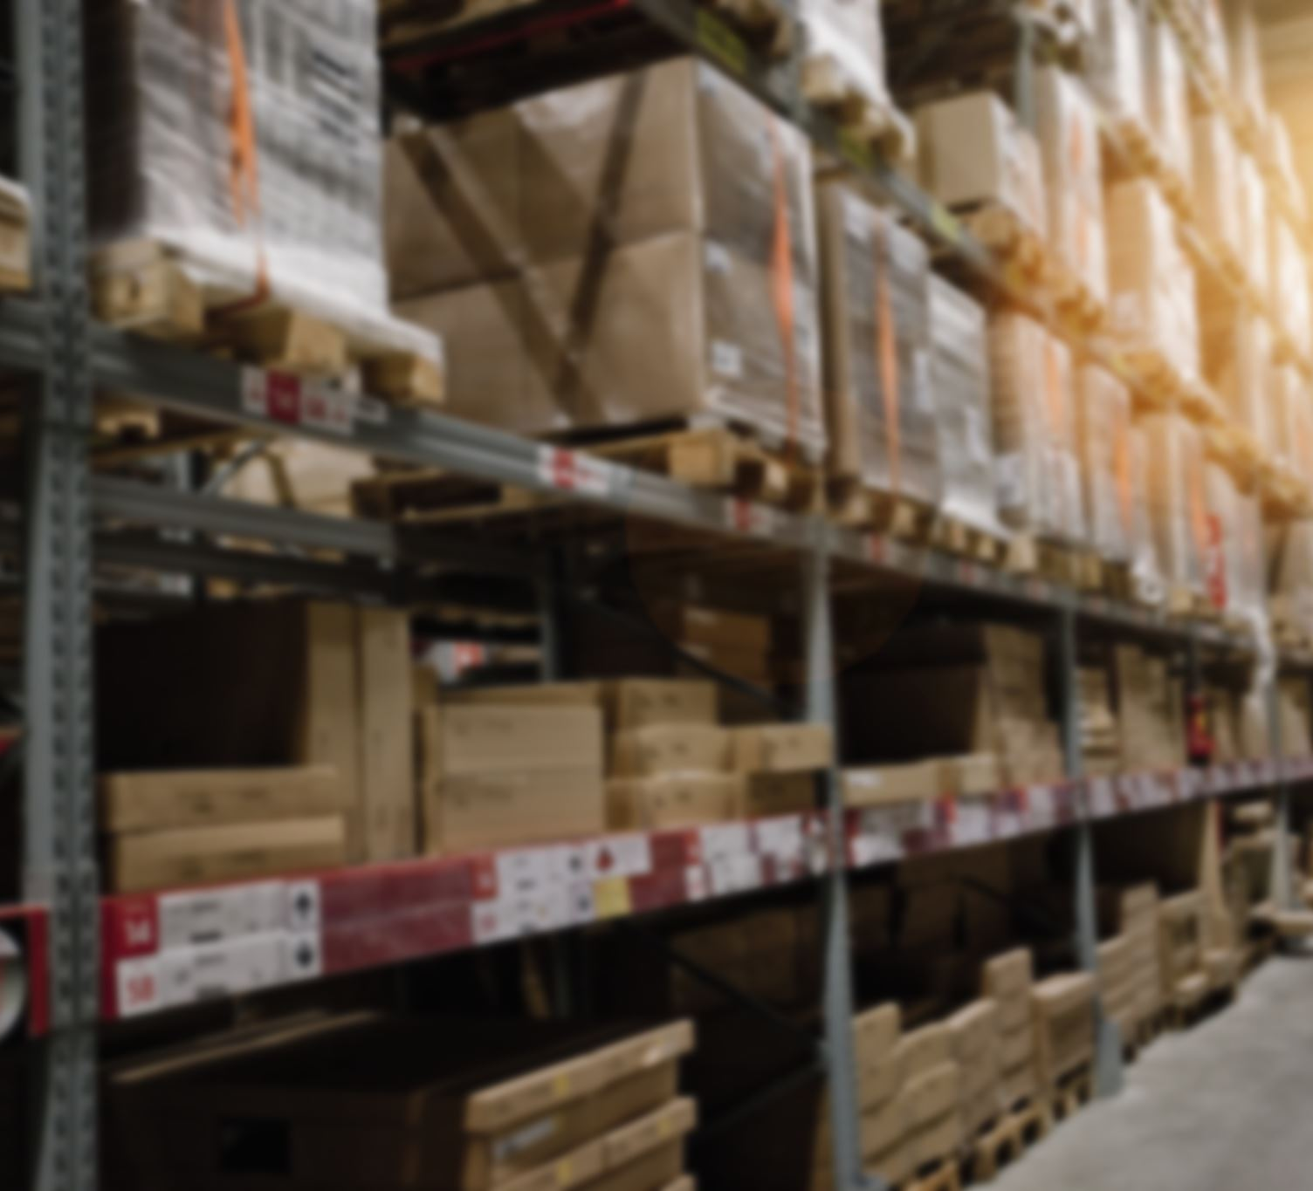
Smart Shelf: tEAM MEMBER: Monserrat Perez
Sales and Inventory System for Small Retail Businesses
https://github.com/ksu-is/Smart-Shelf
Key Features:
easy-to-understand way to manage sales and inventory
help small businesses track sales, inventory, and product performance
helps business owners make better decisions, increase profit, and stay organized without needing to rely on advance technology

